Slide 1

2020
March Madness Prediction
Team: Big Four
Chenjing Lyu
Yanyan Deng
Zhichao Lyu
Ziwei Li

Slide 2

Overview
Objective:
Establish models to assess the probability of each team winning the March Madness game
Robust Model:
Ensemble model with accuracy of 78.69%

Slide 3
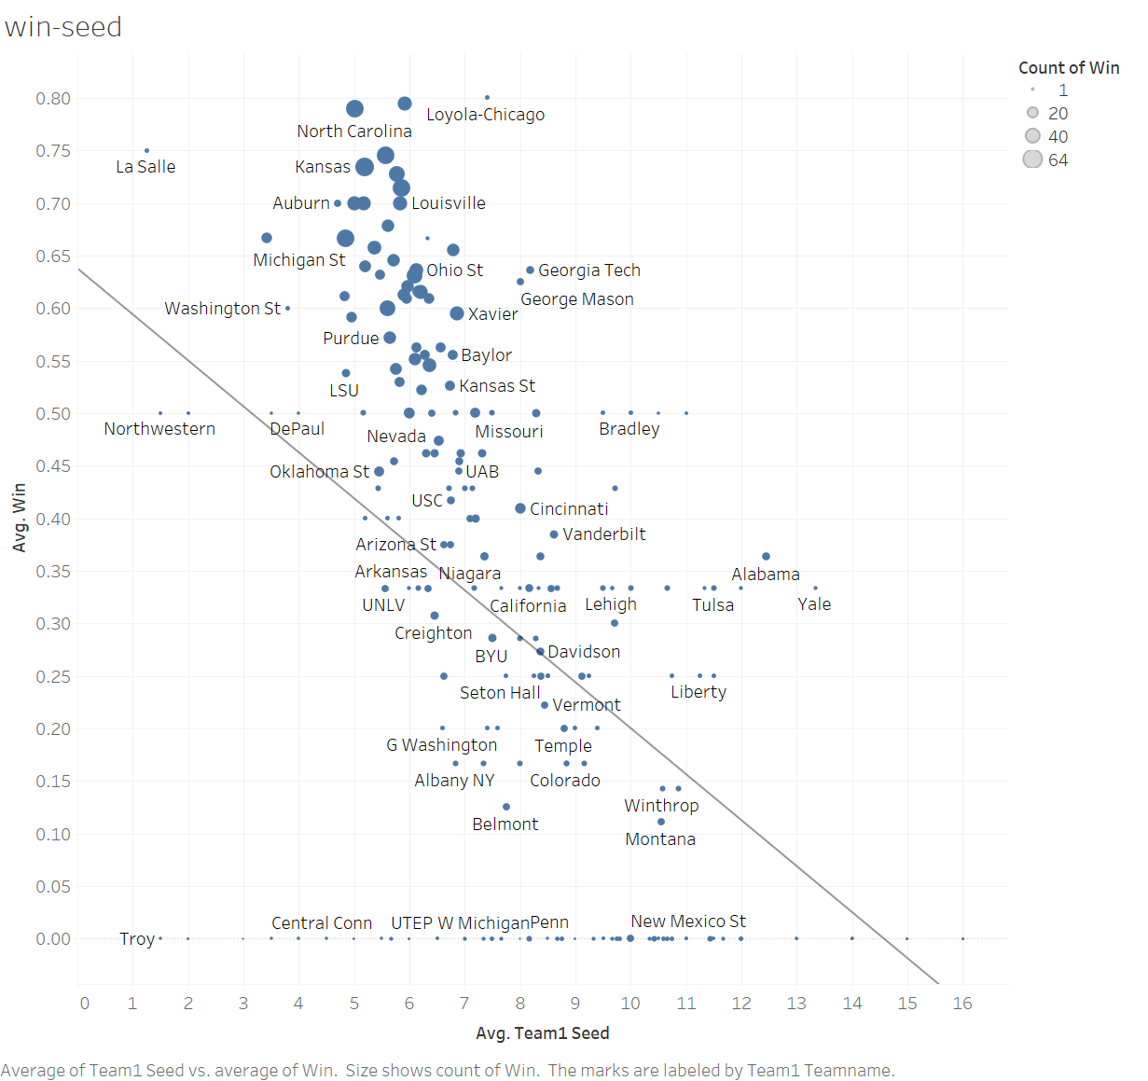
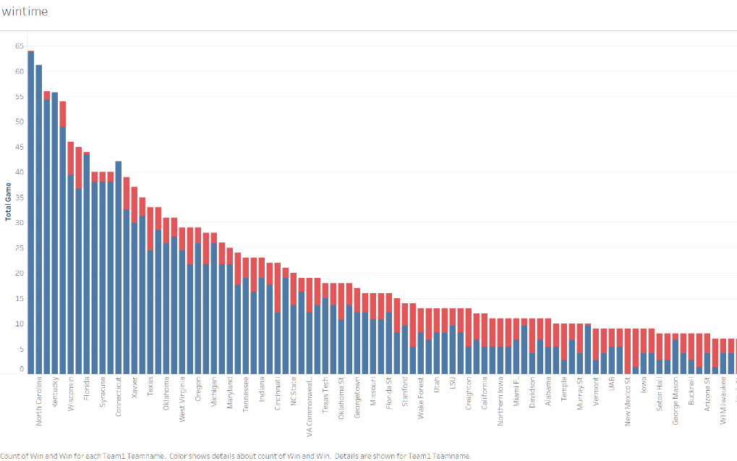
Data Exploration
Figure1: Total Game vs. Win time for each team
Figure 1 aggregate the total game a team played
and how many times it wins. This chart shows that the
more times a team participates in a match, the more it wins.
Figure 2 shows that the team seed is a good indicator for the result of game. The team who has larger average team seed is more likely to have a better win rate.
Figure2: Avg. Team Seed and Avg. Win time

Slide 4
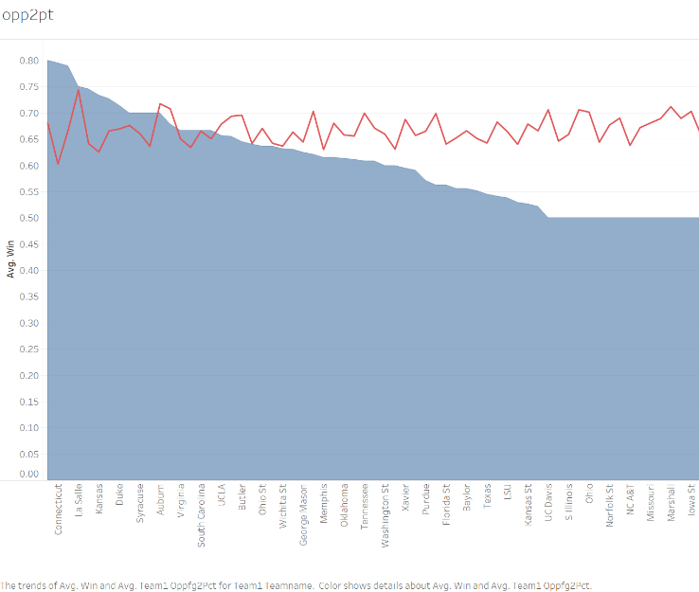
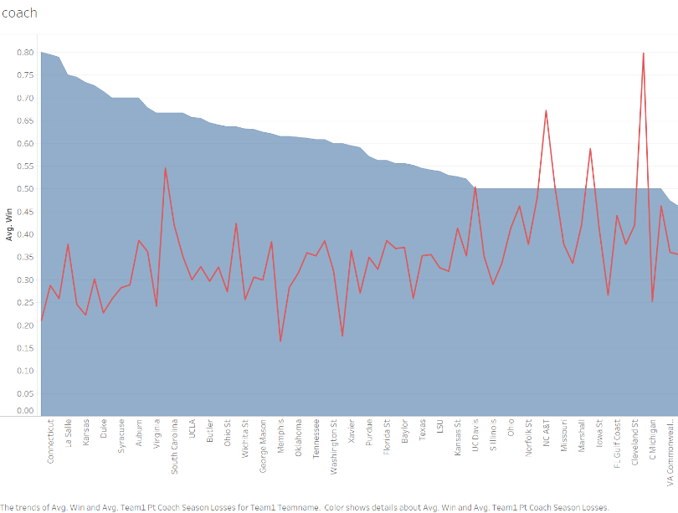
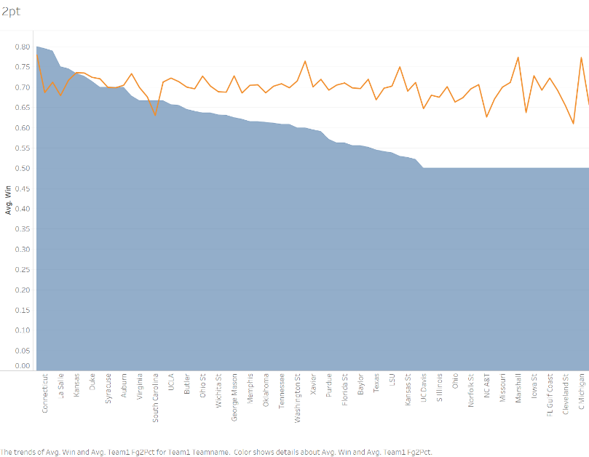
Data Exploration
Figure4: Win Rate and 2 pt Shooting Percent
Figure3: Win Rate and Coach Season Win
Figure5: Win Rate and 2 pt Shooting Percent
of Opponent’s
Figure 3, 4, and 5 put the game win rate of each game (the blue area) and 3 other statistical indicators together (the three lines). It is hard to see any pattern in these three charts.
Therefore, these statistics cannot predict the winning or losing of a team as good as the team seed. So our task is to find out which indicators are suitable for predicting winning or losing.

Slide 5
Data Preprocessing
Missing data: We could find some missing variables in column “ap_final”, “ap_preseason”, and so on. We are going to simply replacing these missing values with 0. Because these represent “rank” and rank 0 means nothing. We can do further modeling.
Converting the categorical data into dummy variables (0 and 1). So that we can input these values into our model.
Splitting one specific game into two separate games. The two sets of data store the information of the winning team and the losing team, respectively.
For the convenience of research, we have added a new column called “Win” to indicate the team's winning or losing. 1 means win and 0 means lose

Slide 6
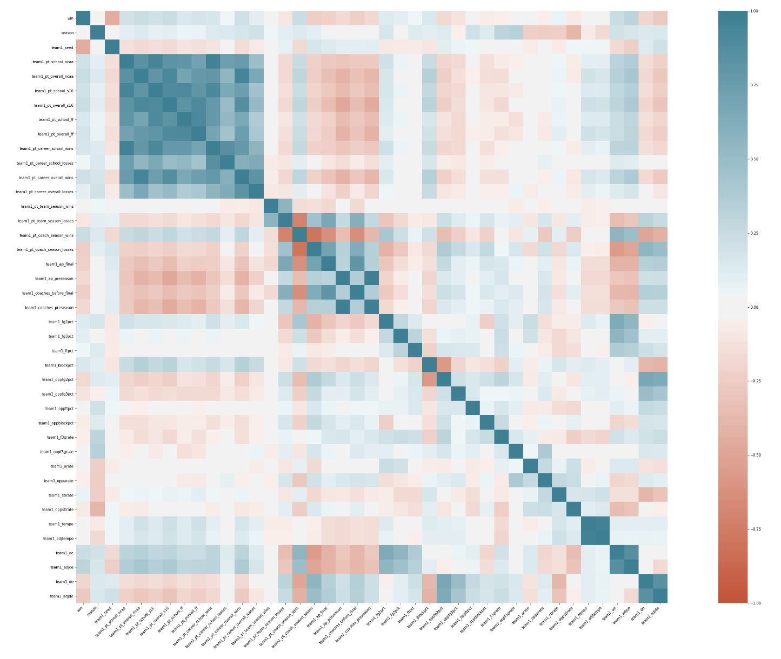
Feature Selection
To decide which variables is suitable for prediction, we build a correlation coefficient matrix as Figure 6 shows.
The matrix quantified how strong the correlation between the variables was. (Red represents strong positive correlation, blue represents strong negative correlation, and white represents irrelevant)
We need to pay attention to two points:
Which variables have a significant effect on winning or losing
Whether there is an autocorrelation between the selected variables.
Figure6: Correlation coefficient matrix

Slide 7
Feature Selection
Finally, we selected variables whose absolute value of the correlation coefficient was greater than or equal to 0.15. We are going to use these variables as the input parameters of our model. Because we can eliminate half of the irrelevant variables without making the model too simple.
Second, we need to filter from the variables that have no autocorrelation. After checking, we left the following 21 variables as our selected features:
Column Name | Column Name | Column Name | Column Name
seed | pt_career_school_wins | de | pt_coach_season_wins
adjde | pt_overall_ff | coaches_preseason | pt_overall_s16
pt_coach_season_losses | pt_school_ncaa | ap_preseason | pt_overall_ncaa
coaches_before_final | pt_school_s16 | oppfg2pct | oe
ap_final | pt_career_overall_wins | blockpct | adjoe
pt_school_ff

Slide 8
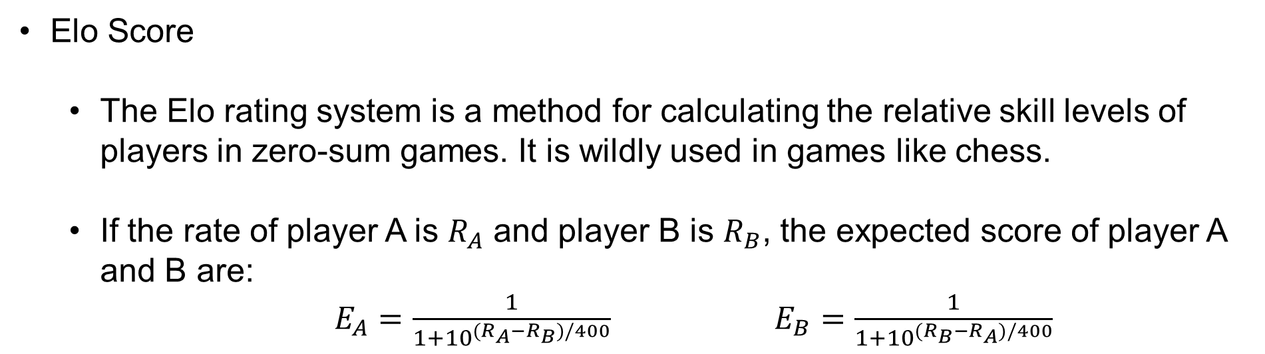
Feature Selection
Elo Score
The Elo rating system is a method for calculating the relative skill levels of players in zero-sum games. It is wildly used in games like chess.
If the rate of player A is $R_{A}$ and player B is $R_{B}$, the expected score of player A and B are:
$E_{A}=\frac{1}{1+{10}^{(R_{A}−R_{B})/400}}$ $E_{B}=\frac{1}{1+{10}^{(R_{B}−R_{A})/400}}$
As we analyzed in the first slide, the ranking of the team is a very important factor affecting the winning or losing of the team. So we introduced Elo score as our other feature.

Slide 9
Modeling
After selecting the feature, we can build our model to predict the game results.
We are going to use four models: K Nearest Neighbor(KNN), Support Vector Machine (SVM), Random Forest, and Artificial Neural Network (ANN) model. Because the model is obviously non-linear. We need to use complex models to predict the results.
We also need to do cross validation to test our model so that we can avoid problems like overfitting.

Slide 10
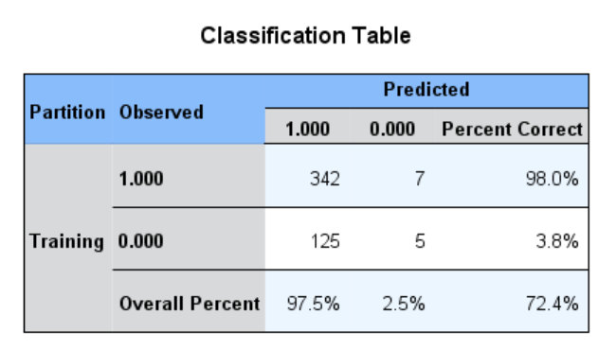
Modeling - KNN
Figure7:Accuracy of KNN Model
Figure8: KNN Classification
KNN predict the result by finding the closest example in the given dataset. It is also a model that is easy for visualization. Figure 8 shows relationship between first three features and the game result. The kind of two points in the picture have obvious different features. So this model will work.
Figure 7 show the accuracy of KNN model. 72.4% is an acceptable number.

Slide 11
Modeling – SVM, Random Forest, and ANN
These three models are another kind of supervised model. Since we have more than 20 features, these models could be more powerful in the complex background.
But unlike the KNN model, they cannot be easily visualized. So we can only have a glimpse at the accuracy of these three model.
Our model uses 10-fold validation to test the model.
Model | Accuracy
SVM | 77.30%
Random Forest | 75.46%
ANN | 77.94%

Slide 12
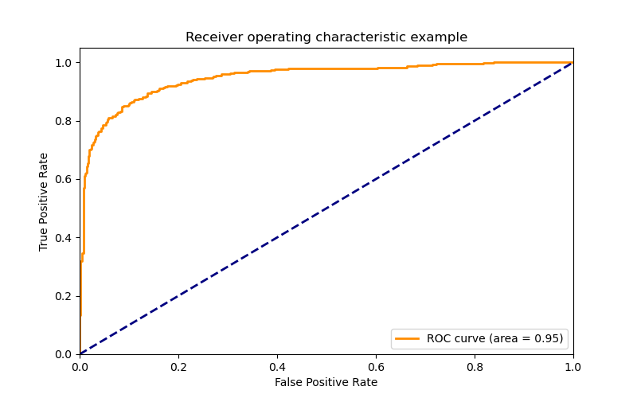
Modeling - Ensemble
To make our model more accurate. We use a further method -- ensemble model.
It is a model that aggerate all previous model together and then, just like a kind of “vote”, select the most possible result.
Finally, we got the accuracy of 78.69%. Although there was no big differences, it is the best result we could get.
The ROC curve shows that our model is a relatively good model.
Figure7: ROC Curve

Slide 13
Conclusion & Recommendation
After selecting 21 data features, we used four models to predict the result. These results are acceptable.
The results also indicate some practical advices also:
We only found that two technical indicators have a certain effect on the results. Maybe the technical indicators have not played a big role in predicting the results.
The history of the team's winning situation greatly affects winning or losing.
According to the data, the coach should best train the ability of the block. Technically, only the blocking most affects the probability of winning.

Slide 14
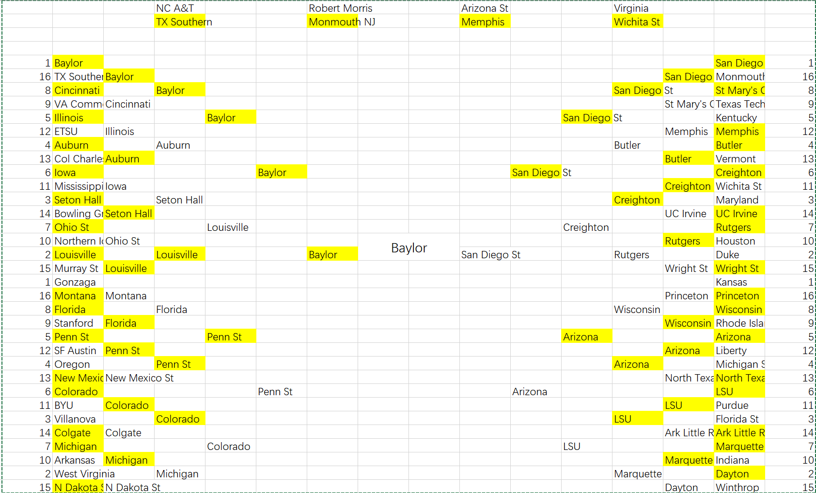
Prediction
Baylor is the winner!

Slide 15
Thank You

